Slide 1
PLTG: Tips and Tricks for Captivate 5.5
Simplify Captivate with the tools
Object Styles
Master slides
Templates
Capturing
Editing
February 10, 2012

Slide 2
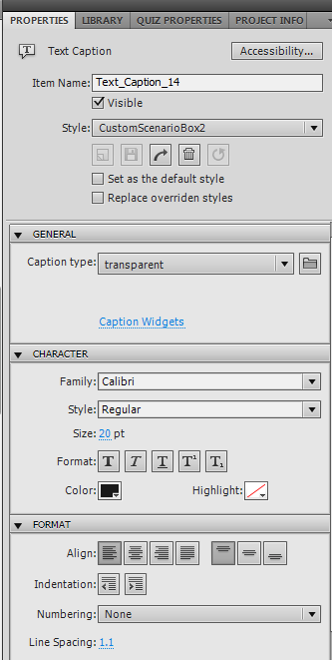
Object Styles
Format captions, highlight boxes etc.
Click the object, then Properties
Use the Edit>Object Style Manager to delete/rename unwanted styles
Check all sections for unwanted styles, not just captions

Slide 3
Properties buttons
+ sign means object has been directly formatted (style overridden)
Curly arrow resets the object to the saved style
Use little arrow to apply changes to all items

Slide 4
Properties Buttons
Curved arrow means apply the current style to any objects with xxx style applied.
Only works if styles are applied consistently.
Gotcha: you have to remember what style was originally applied!

Slide 5
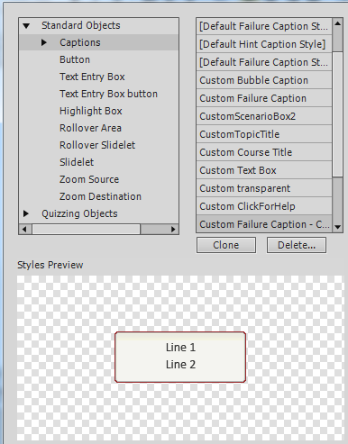
Object Style Manager
Under Edit menu
Different styles for different types of objects – not just captions
To export styles from the Object Style Manager
Select ‘All styles of all objects’

Slide 6
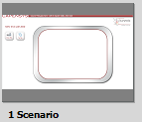
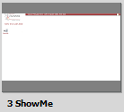
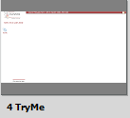
Master slides
Design different masters for each type of slide.
Objects on master slides are not interactive
Can’t put click boxes on master slides
Master slides can be copied from one presentation to another

Slide 7
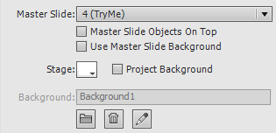
Slide Properties
Blank slide instead of captured image?
Check if ‘Use Master Slide Background’ is selected
‘Stage’ changes background color
E.g., for title slides
Can apply the background in one slide to another slide

Slide 8
Templates
Don’t work in a template:
Base a new project on a template
Projects cannot be saved as templates. If you have a project to convert to a template:
Start new template
Copy master slides
Export Styles/Preferences and import them
Multiple templates for multiple purposes

Slide 9
Capturing
Practice, practice, practice!
Consider creating a Custom mode
Capture entire sequence at a time
Less risk of slides shifting position
Edit capture.ini file – ‘mouse=1’
Captures button without selection, then with (2 slides)

Slide 10
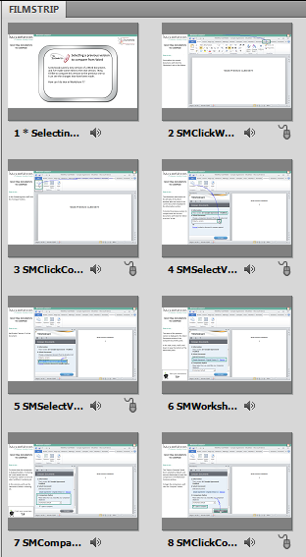
Editing
Name slides
Names that describe actions in slide
Use marker for slides to appear in the TOC, e.g. asterisk
Consider naming backgrounds and audio to match
To patch graphic, capture with horizontal/vertical lines

Slide 11
Editing
Use Project/Advanced Interaction to check click boxes and other interactive objects

Slide 12
Resources
Forums.Adobe.com
Linked-in forums
http://lilybiri.posterous.com/
http://www.cpguru.com/ (widgets)
http://www.infosemantics.com.au/
Me! mdeland@capensys.com

